Slide 1
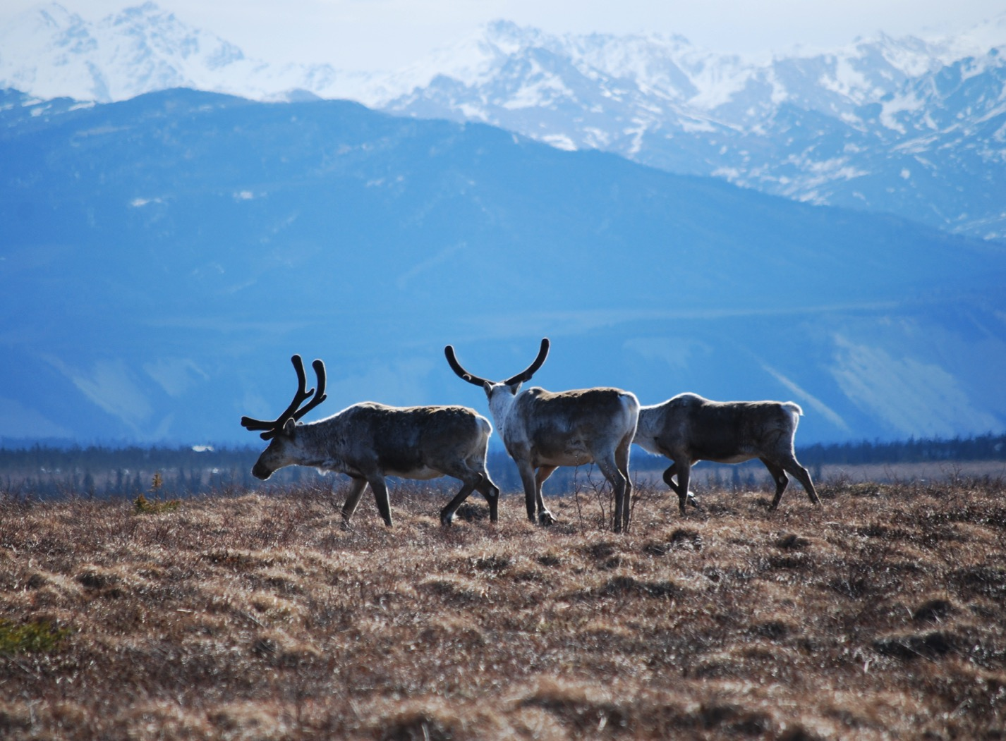
Arctic Boreal Vulnerability Experiment (ABoVE)
2017 ABoVE Airborne Campaign
20 July 2017 (DOY 201)
AirSWOT/Ka-SPAR:
Fort Yukon Joint Ground-Air Survey
Charles Miller, Deputy Science Lead
Jet Propulsion Laboratory, California Institute of Technology
and the ABoVE Science Team For Hank Margolis, Eric Kasichke, Bruce Tagg
NASA HQ
2017

Slide 2
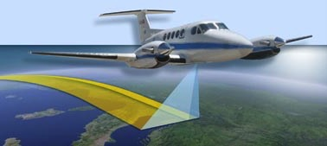
20 July 2017/DOY 201 Fort Yukon Joint Ground-Air Survey
Daily Status:
AirSWOT / N801NA ABoVE CAMPAIGN (CANADA / ALASKA)
REPORT DATE: 20 July 2017
Current Status of Aircraft: GREEN
Current Status of Radar: Yellow Failed receiver (socket 5)
Current Status of Camera: RED Camera failed after 51 shots
Current Status of Crew: GREEN
Current Deployment Location: Fairbanks International Airport (PAFA)
Crew: Salling, Posada, Chao, Soto
Science Coordinators: T Pavelsky, C Rains
Science Lead: L Smith
Project Manager: Y Lou

Slide 3
20 July 2017/DOY 201 Fort Yukon Joint Ground-Air Survey
Daily Summary:
AirSWOT team took off around 0915 local this morning and flew 10 central Yukon Flat lines (FLIGHT PLAN PAVE_0072).
Weather condition were mostly overcast with sky broken from time to time.
IR camera stopped working during the 2nd line and crew was unable to revive it after 51 shots were taken.
Replacement camera #2 is now installed on NASA801
Crew discovered the replacement camera had a damaged “flash sync” connector. Without this connector, the unit can still take pictures using the intervalometer. However, it will not register the events with timestamps from on board GPS unit.
Ground team deployed near Fort Yukon making concurrent lake and river height measurements
Active precipitation during AirSWOT overflight

Slide 4
20 July 2017/DOY 202 72-Hour Look Ahead
All plans weather dependent
Friday 21 July 2017 (DOY 202):
Sag River joint ground-air survey #2
Saturday 22 July 2017 (DOY 203):
Return to Palmdale CA/AFRC

Slide 5
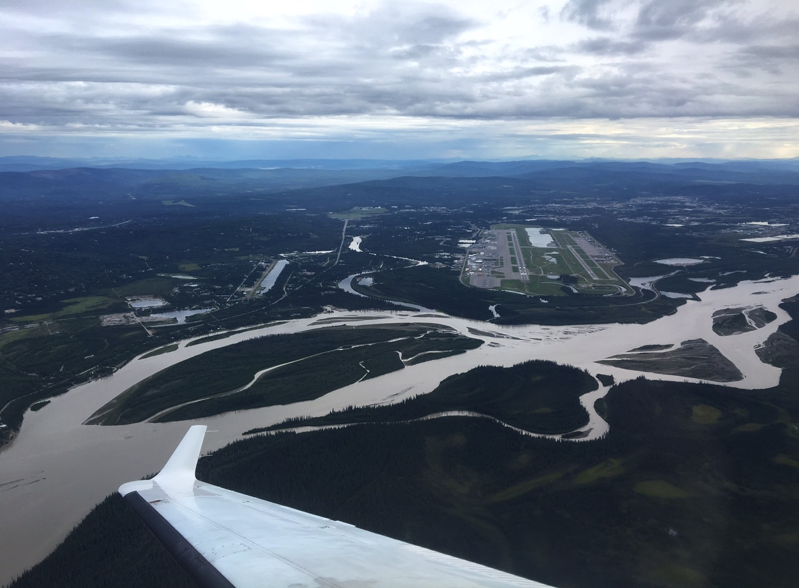
View of PAFA and the Tanana River just after takeoff

Slide 6
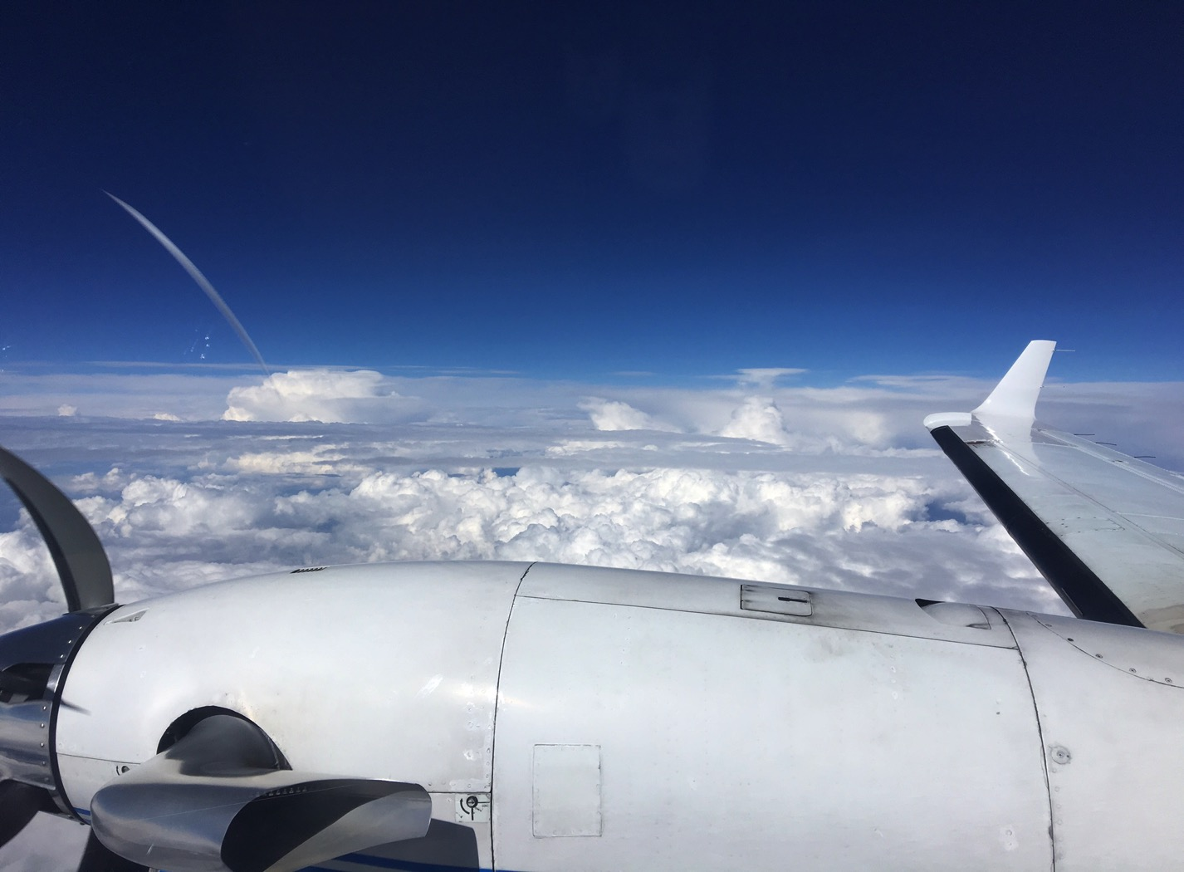
20 July 2017/DOY 201 Fort Yukon Joint Ground-Air Survey
Storms building over the Yukon Flats

Slide 7
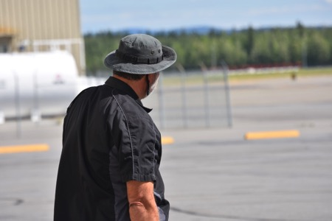
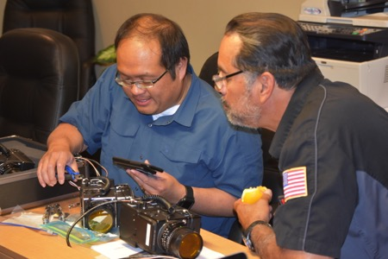
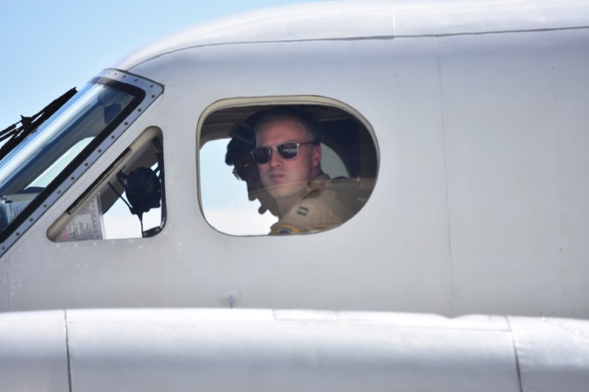
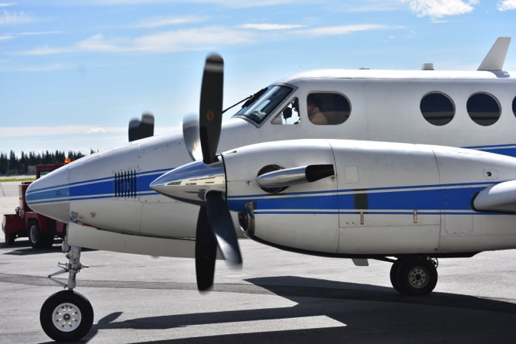
20 July 2017/DOY 201 Fort Yukon Joint Ground-Air Survey

Slide 8
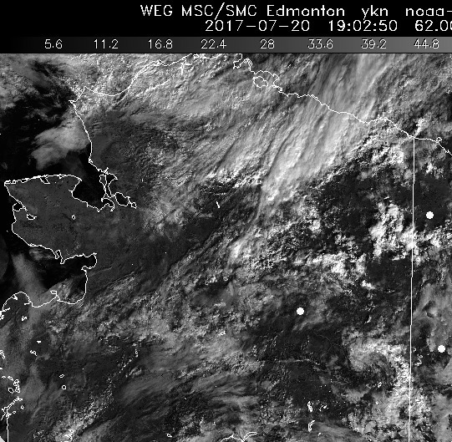
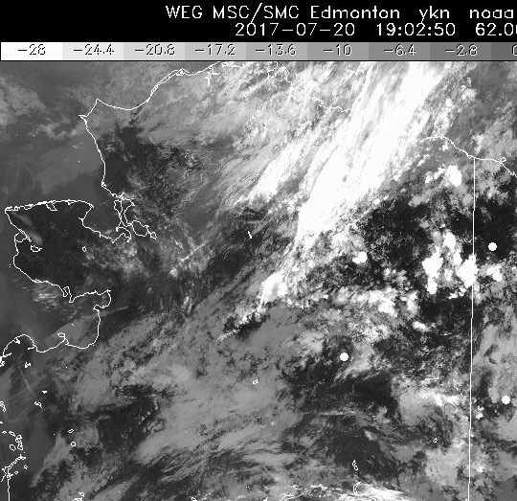
20 July 2017/DOY 201 Fort Yukon Joint Ground-Air Survey
HRPT Visible
1902Z
HRPT IR
1902Z
Partly cloudy to overcast over the Yukon Flats
Notes:
Conditions cleared after 1300

Slide 9
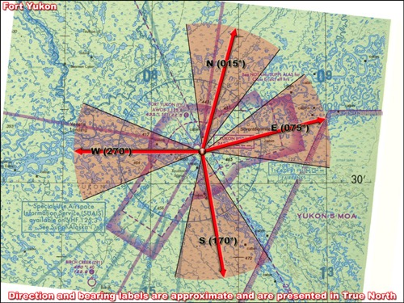
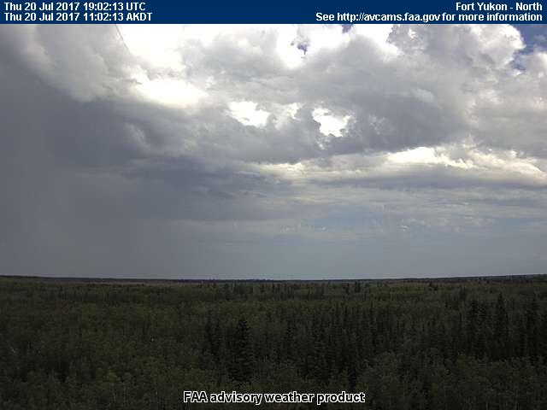
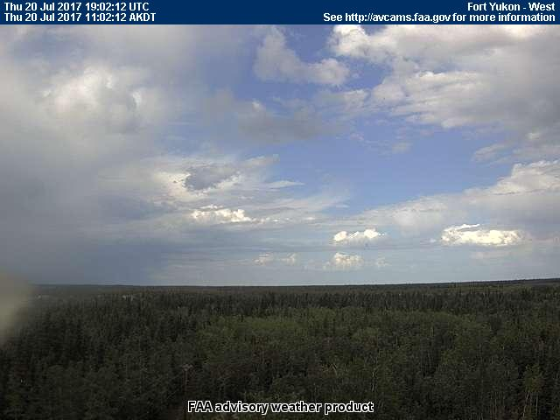
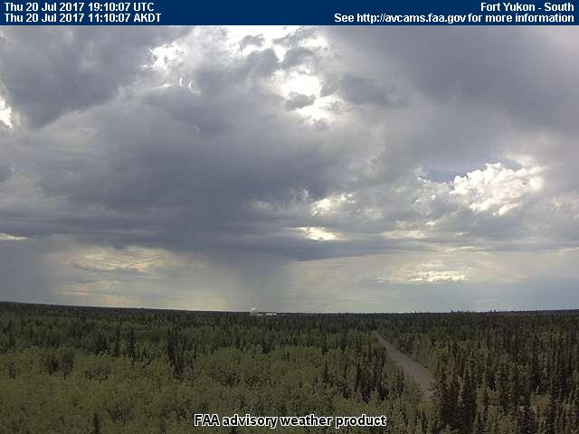
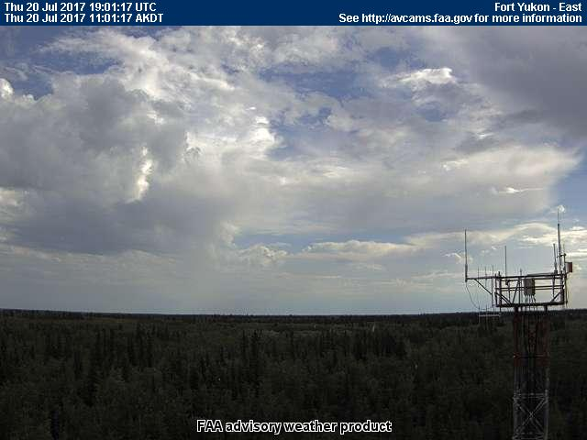
20 July 2017/DOY 201 Fort Yukon Joint Ground-Air Survey
Fort Yukon (FYU) (PFYU)
NORTH
North
West
South
East
Notes:
AVCAM sky pictures from Fort Yukon show mostly overcast skies despite forecast for clear sky conditions and clear skies in the vicinity
See http://avcams.faa.gov/ for an interactive map of Alaska aviation cameras

Slide 10
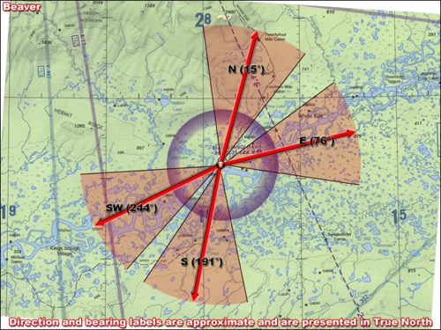
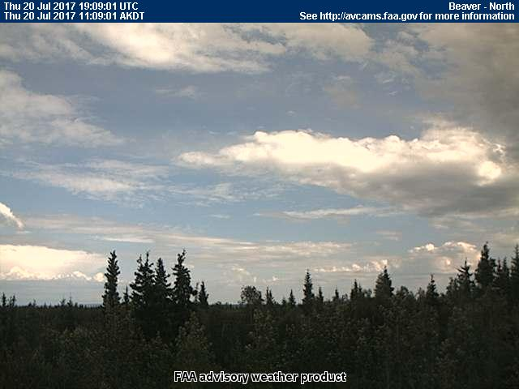
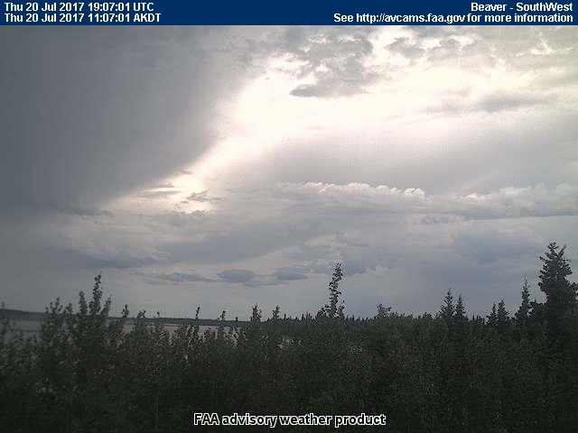
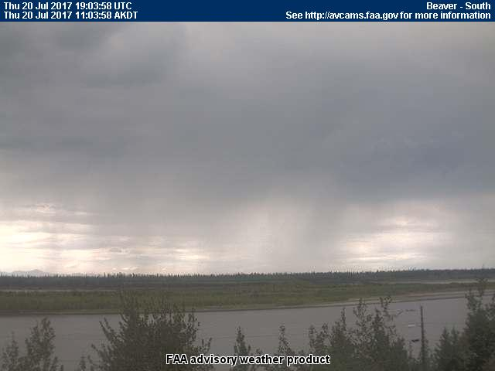
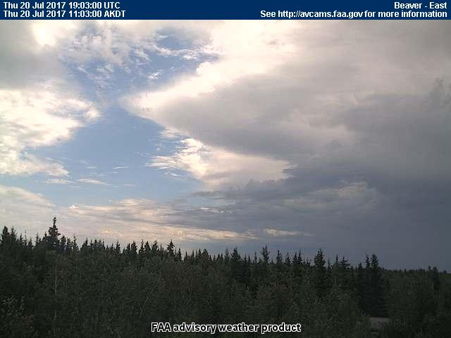
20 July 2017/DOY 201 Fort Yukon Joint Ground-Air Survey
Beaver (WBQ, west of Fort Yukon)
NORTH
North
Southwest
South
East
Notes:
AVCAM sky pictures from Beaver showing areas of clear skies to the east and north (Fort Yukon area) with heavy overcast to the south and southwest
See http://avcams.faa.gov/ for an interactive map of Alaska aviation cameras

Slide 11
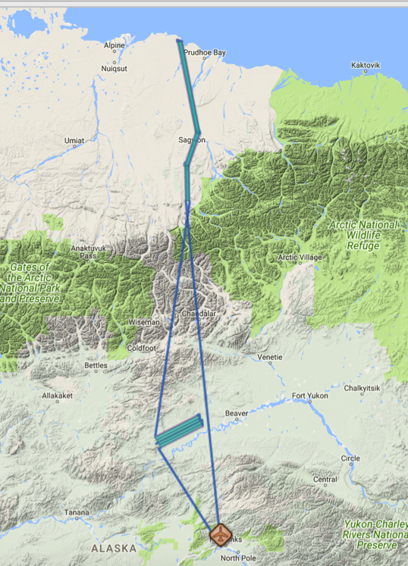
20 July 2017/DOY 201 Fort Yukon Joint Ground-Air Survey
Flight Plan Report: pavelky_0072 (YF West Sag River May 31)
https://flightplanning.jpl.nasa.gov/cgi-bin/report.pl?planID=pavelky_0072#summary
Flight plan & acquisition segments
Data Acquisitions:
Line 1 pave01_063aa
Line 2 pave02_243aa
Line 3 pave03_063aa
Line 4 pave04_243aa
Line 5 pave07_359aa
Line 6 pave05_019aa
Line 7 pave06_349aa
Line 8 pave08_169aa
Line 9 pave09_199aa
Line 10 pave10_179aa
Lines 1-4 not acquired on 7/19/17
pave06_349aa
pave08_169aa
pave05_019aa
pave09_199aa
pave07_359aa
pave10_179aa
pave01_063aa
pave02_243aa
pave03_063aa
pave0$_243aa

Slide 12
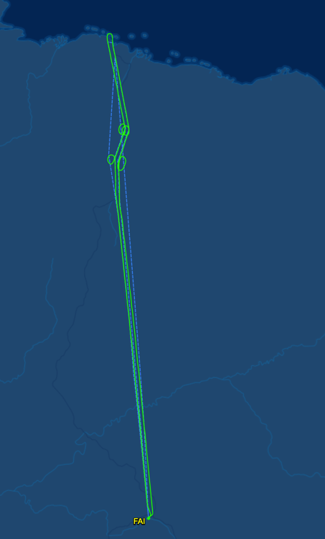
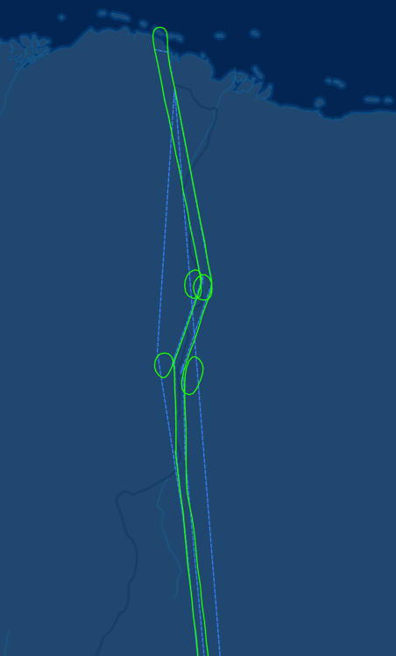
20 July 2017/DOY 201 Fort Yukon Joint Ground-Air Survey
Flight Plan Report: pavelky_0072 (YF West Sag River May 31)
https://flightplanning.jpl.nasa.gov/cgi-bin/report.pl?planID=pavelky_0072#summary
Deadhorse AK (PASC)
Deadhorse AK (PASC)
Data Acquisitions:
Line 1 pave01_063aa
Line 2 pave02_243aa
Line 3 pave03_063aa
Line 4 pave04_243aa
Line 5 pave07_359aa
Line 6 pave05_019aa
Line 7 pave06_349aa
Line 8 pave08_169aa
Line 9 pave09_199aa
Line 10 pave10_179aa
Lines 1-4 not acquired on 7/19/17
pave06_349aa
pave08_169aa
pave05_019aa
pave09_199aa
pave07_359aa
pave10_179aa
As-flown lines & acquisition segments
Fairbanks AK
(PAFA)
Sag River
Area Detail

Slide 13
20 July 2017/DOY 201 Fort Yukon Joint Ground-Air Survey
Quick-look products to be generated

Slide 14
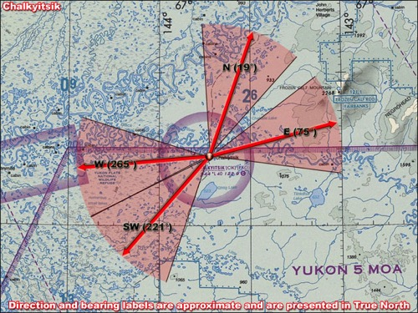
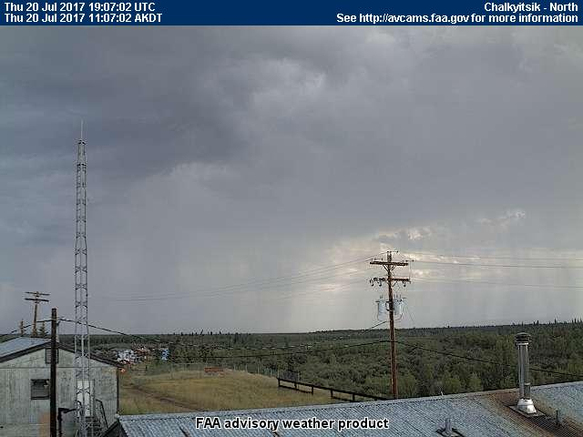
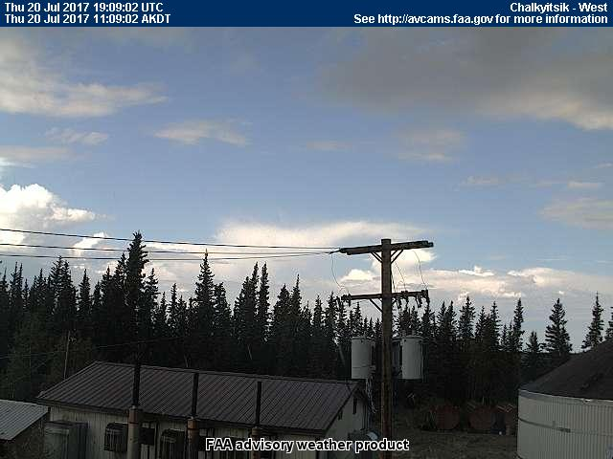
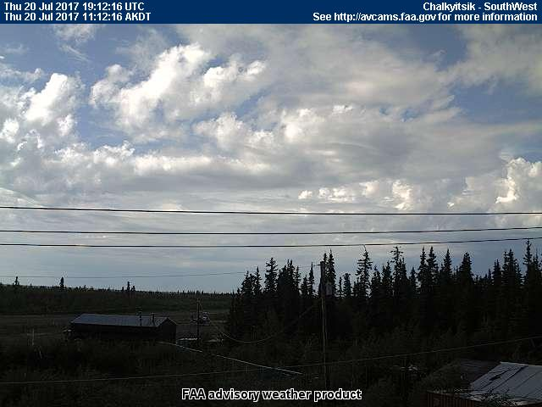
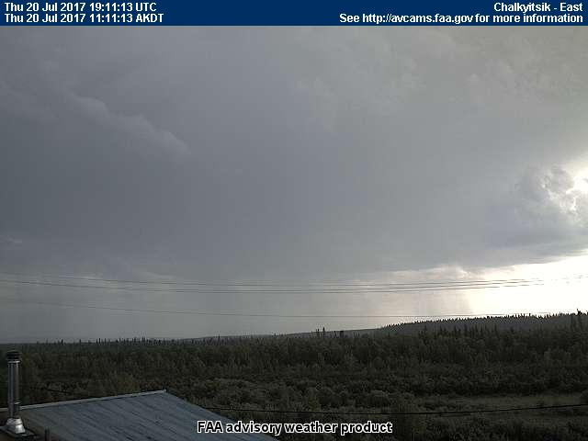
20 July 2017/DOY 201 Fort Yukon Joint Ground-Air Survey
Chalkyitsik Airstrip (east of Fort Yukon)
NORTH
North
West
Southwest
East
Notes:
AVCAM sky pictures from Chalkyitsik showing open to partly cloudy skies to the west and southwest (Fort Yukon), but storms and active precipitation to the east and north
See http://avcams.faa.gov/ for an interactive map of Alaska aviation cameras

